Slide 1
Literature Review
By: Mohammad Kamil

Slide 2
Project Title
Semantically Enriched Expertise Discovery System for Computer Science Specializations

Slide 3
Introduction
Ontology-based system for expert discovery in the field of computer science
Ontology represent academic information
Research publications
Inference individuals expertise
Semantic Web Rule Language (SWRL)
SPARQL
Academic Databases

Slide 4
Project Scope
Ontology Construction
Reasoning
Querying

Slide 5
Existence Systems
There are many systems have been developed but I choose three most similar paper of existing system:
A Probabilistic Model for Fine-Grained Expert Search
Semantic-based information extraction system for matching resumes to job openings
Using Citation Analysis for Finding Experts in Workgroups

Slide 6
1) A Probabilistic Model for Fine-Grained Expert Search
Evidence Extraction
Evidence Quality Evaluation
Document segments in various granularities like evidences
Program looks for info, grades how good it is, and then ranks people based on that info to find the real experts
Investigating the subtle aspects of evidence

Slide 7
2) Semantic-based information extraction system for matching resumes to job openings
Extract data like experience, features, and business and education information from resumes stored in human resources repositories
Ontology driven information extraction system that is planned to operate on several million free-format textual resumes to convert them to a structured and semantically enriched version for use in semantic data mining of data essential in human resources processes
Executed on several million English and Turkish language resumes to convert them to ontological format
Expert finding/detection and aggregation of skills information in a resume pool

Slide 8
3) Using Citation Analysis for Finding Experts in Workgroups
Workgroup members by citation indegree
Sources of expertise: content-based and social networks
Highly cited papers are indicative of the expertise of its authors on the topics covered by those papers
Impact factor
Average number of citations per article a journal receives over a two-year period
Indegree count for each document

Slide 9
Proposed System
Ontology-based system for expert discovery in the field of computer science
Research publications
Inference individuals expertise
Semantic Web Rule Language (SWRL) & SPARQL
Academic Databases
Protege

Slide 10
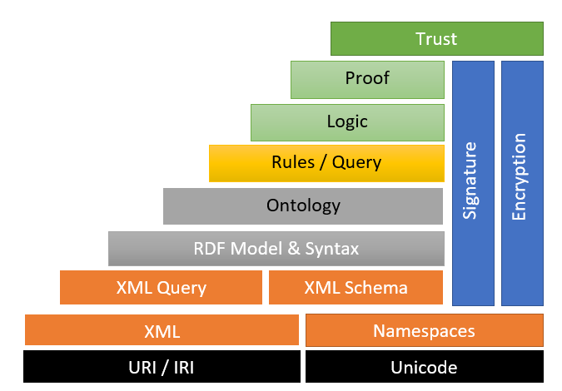
Semantic web architecture

Slide 11
Project Outcomes
Semantic technology-based data model, ensuring a well-defined, structured, and semantically rich representation of academic information in the field of computer science specialization
Different keywords related to computer science fields
The user query generated a list of experts based on keywords associated with the queried field, offering a targeted and refined expert of particular field

Slide 12
Thanks!

